Slide 1


The Dragon Slayer of Montana
Created by Bryson Jex, Adrienn Joseph, and Salem Najera

Slide 2
About the game
Genre: RPG / Dungeon Crawler
Program used: IntelliJ (coded in Java, of course)
Includes 3 classes for the player to play, monsters to fight, and a story of being a hero to enjoy.

Slide 3
Who did what???
Bryson – Monster generator, monsters, and monster combat.
Adrienne – Player and player combat, combat controller, and inventory.
Salem – Story, paths controller, and encounters.

Slide 4
Challenges we had
Story and our path controller
Inventory System
Monster attack method and how they take damage

Slide 5
Successes we had
Laying out the story paths
Establishing each monster class and their creation
Character classes and their abilities

Slide 6
Game demonstration

Slide 7

Thank you!

Slide 8
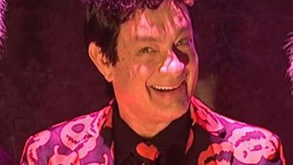
Any questions?

